Slide 1
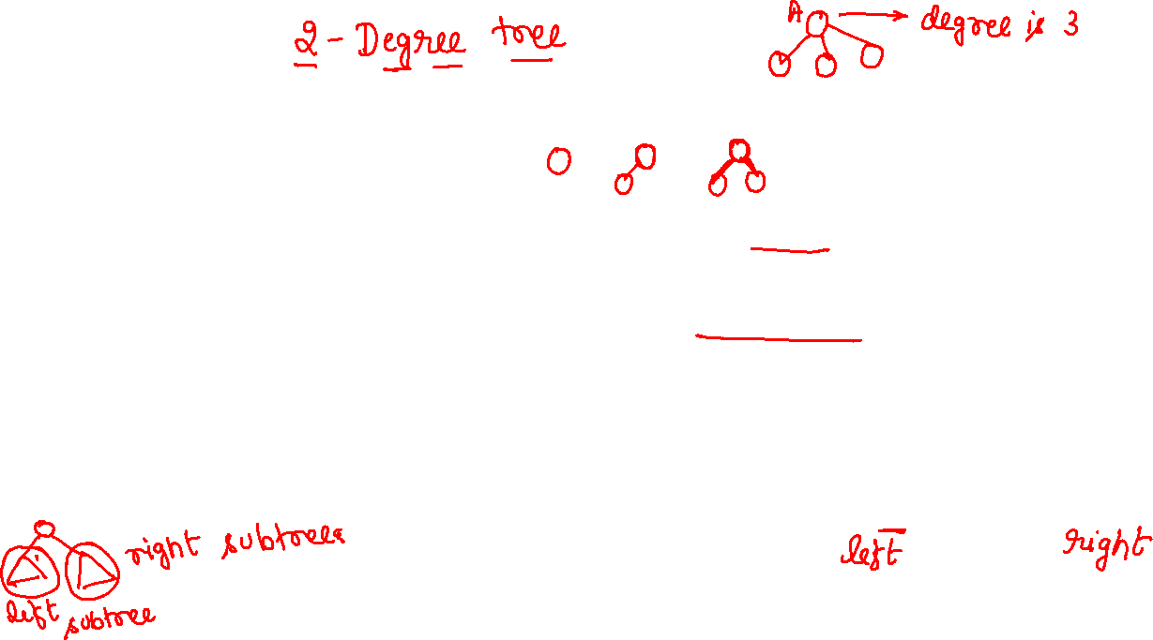
Binary Trees
Binary trees are characterized by the fact that any node can have at most two branches
Definition (recursive):
  A binary tree is a finite set of nodes that is either empty or consists of a root and two disjoint binary trees called the left subtree and the right subtree
Thus, the left subtree and the right subtree are distinguished
Any tree can be transformed into binary tree
  by using left child-right sibling representation
A
A
B
B

Slide 2
Binary tree types

Slide 3
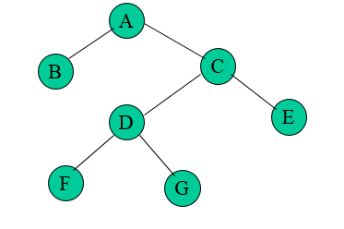
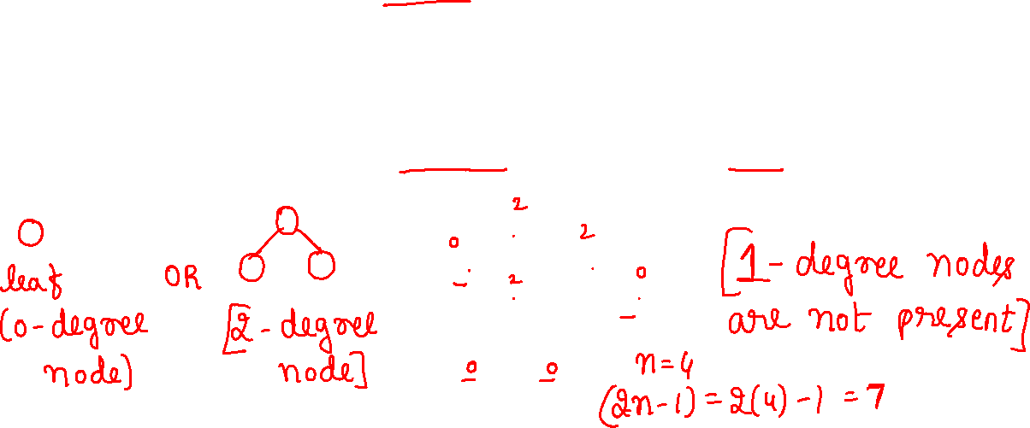
Binary Tree Type: Strictly Binary tree
If every nonleaf node in a binary tree has nonempty left and right subtrees, the tree is called a strictly binary tree.(all non leaf node have degree either two or zero not one)
A strictly binary tree with n leaves always contains 2n -1 nodes.

Slide 4
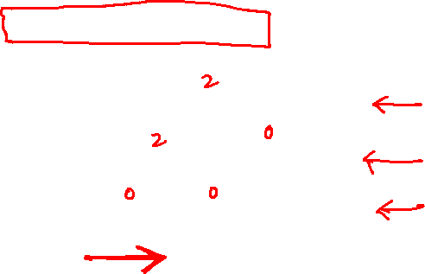
Binary Tree Type: Complete Binary tree
A complete binary tree is a binary tree whose all levels except the last level are completely filled and all the leaves in the last level are all to the left side and is strict binary tree.

Slide 5
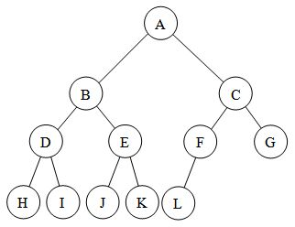
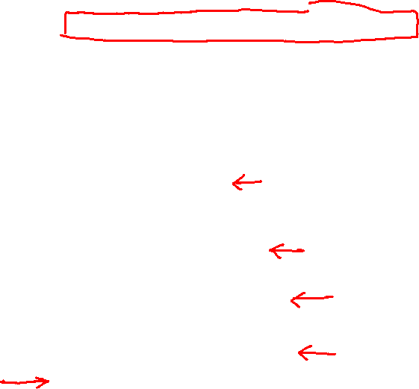
Binary Tree Type: Almost Complete Binary tree
An almost complete binary tree is a binary tree whose all levels except the last level are completely filled and all the leaves in the last level are all to the left side and need not be strict binary tree.
Every complete BT is also almost complete but every almost complete binary tree need not be complete.

Slide 6
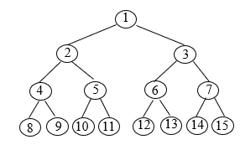
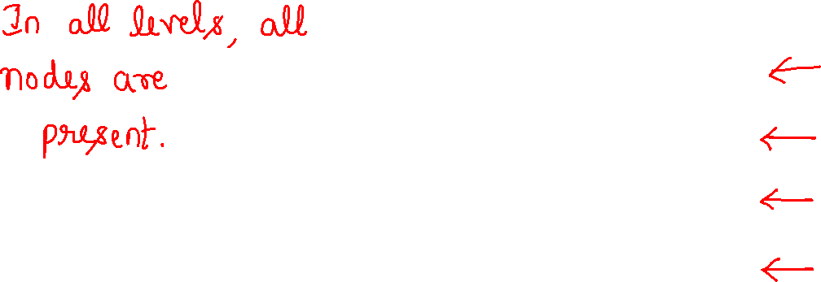
Binary Tree Type: Full Binary Tree

Slide 7
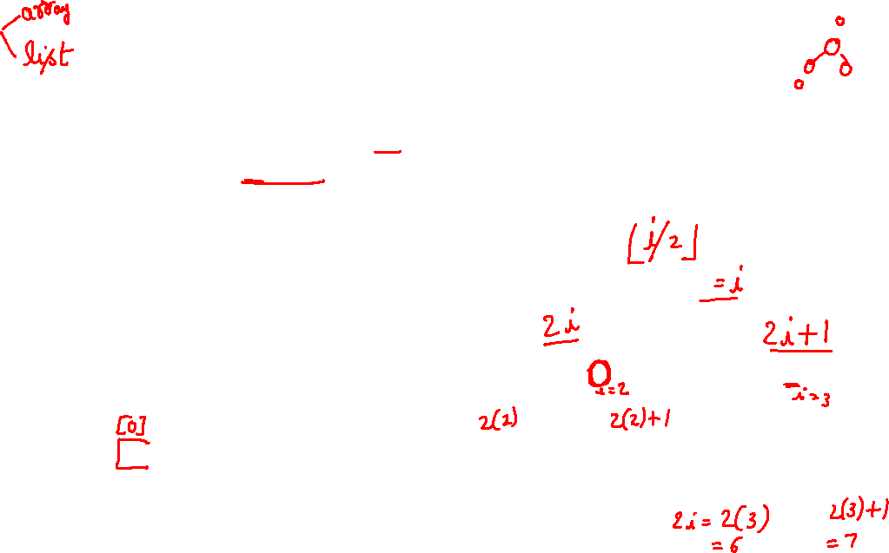
Binary Trees
Binary tree representations (using array)
  Lemma 5.3: If a complete binary tree with n nodes is represented sequentially, then for any node with index i, 1 ≤ i ≤ n, we have
  parent(i) is at ⎣i /2⎦ if i ≠ 1.
  If i = 1, i is at the root and has no parent.
  LeftChild(i) is at 2i if 2i ≤ n.
  If 2i > n, then i has no left child.
  RightChild(i) is at 2i+1 if 2i+1 ≤ n.
  If 2i +1 > n, then i has no right child
A
1
B
2
C
3
[1]
[2]
[3]
[4]
[5]
[6]
[7]
A B C — D — E
D
E
Level 1
4
5
6
7
Level 2
Level 3

Slide 8
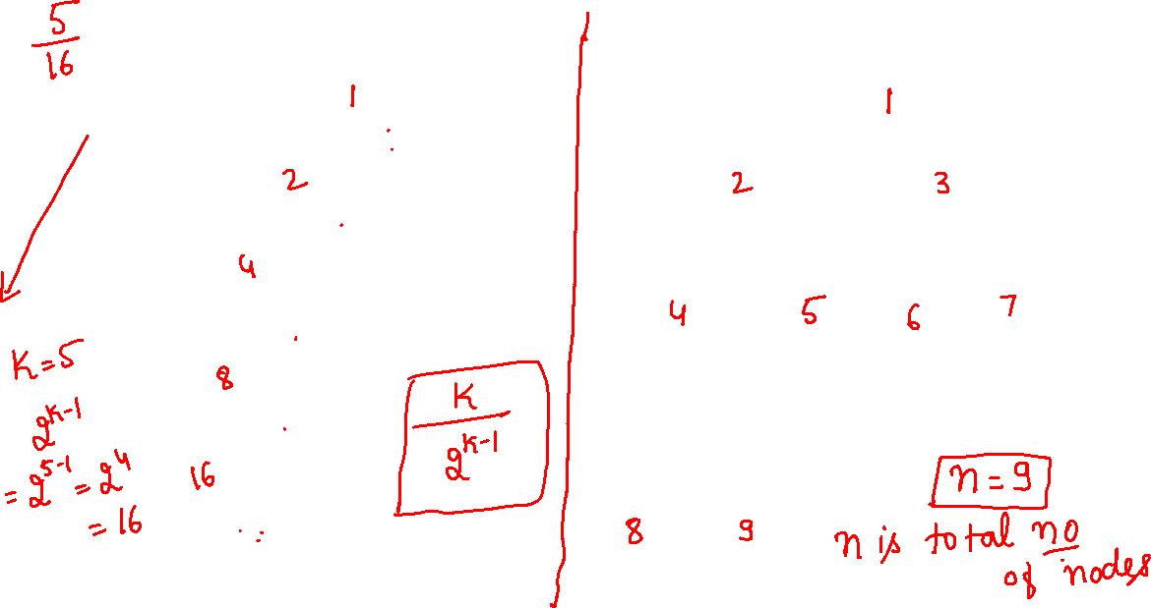
Samples of Trees
Skewed Binary Tree
Complete Binary Tree
1
A
A
2
B
B
C
3
C
D
E
F
G
4
D
H
I
5
E

Slide 9
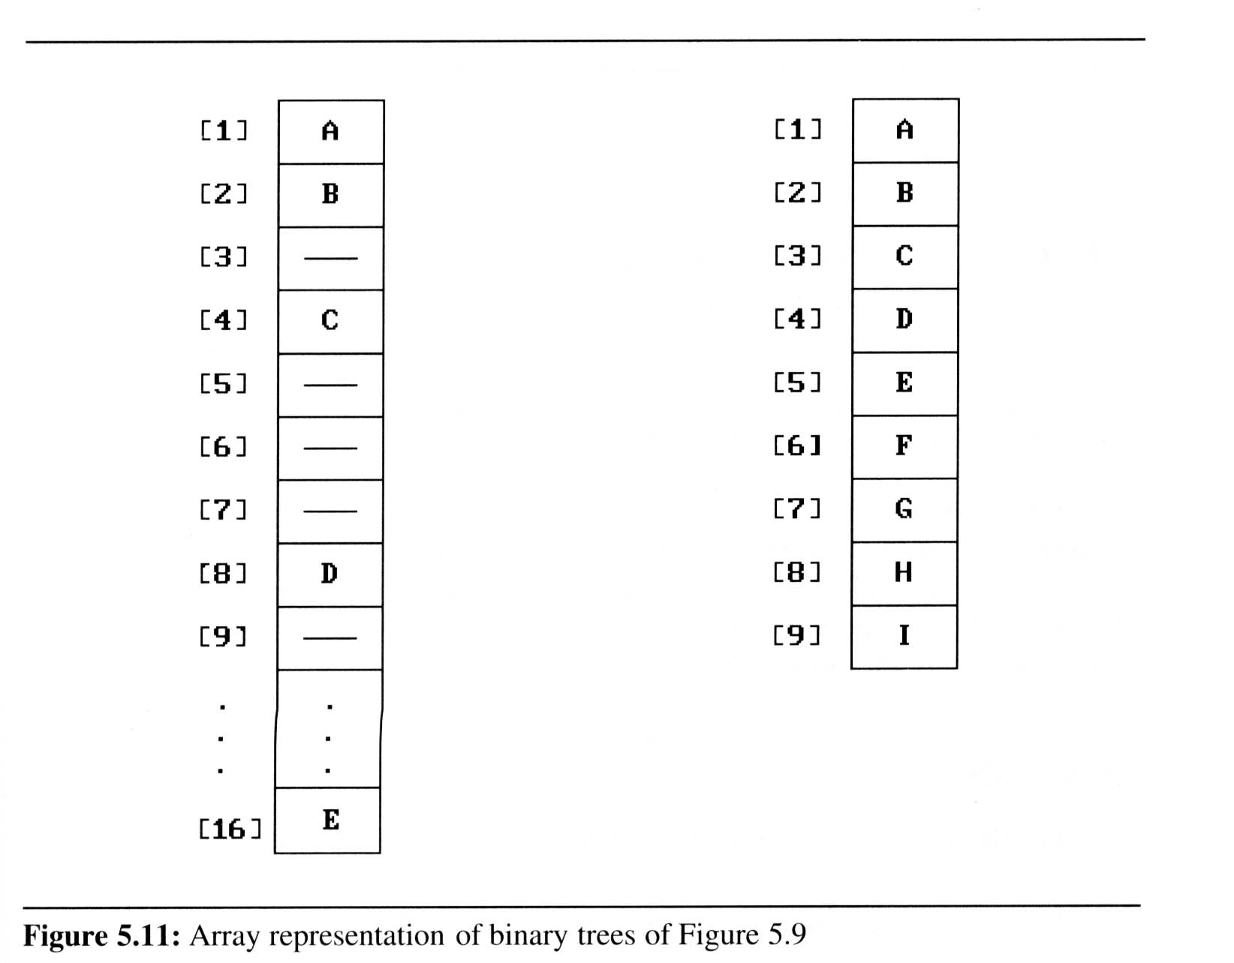
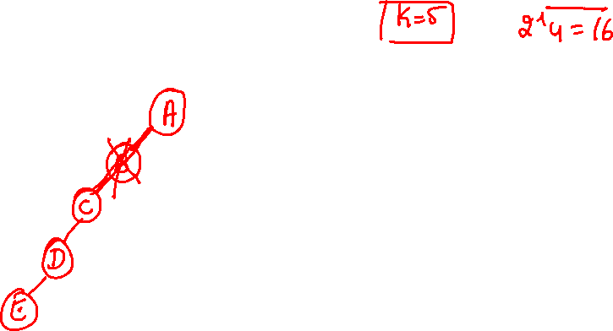
Binary Trees
Binary tree representations (using array)
  Waste spaces: in the worst case, a skewed tree of depth k requires 2^(k-1) spaces. Of these, only k spaces will be occupied
  Insertion or deletion
  of nodes from the
  middle of a tree
  requires the
  movement of
  potentially many nodes
  to reflect the change in
  the level of these nodes

Slide 10
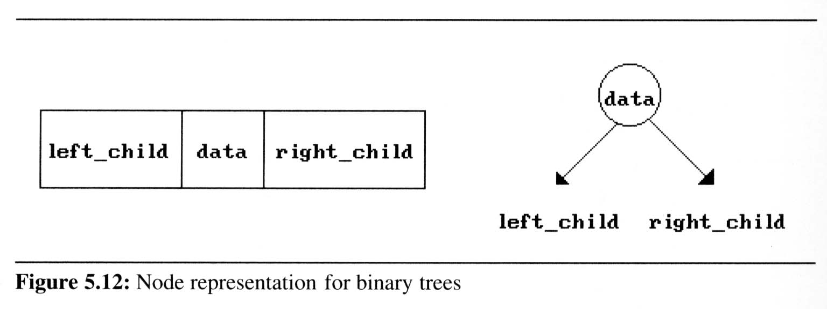
Binary Trees
Binary tree representations (using link)
class tree_node
{
int data;
tree_node *lc,*rc;
};

Slide 11
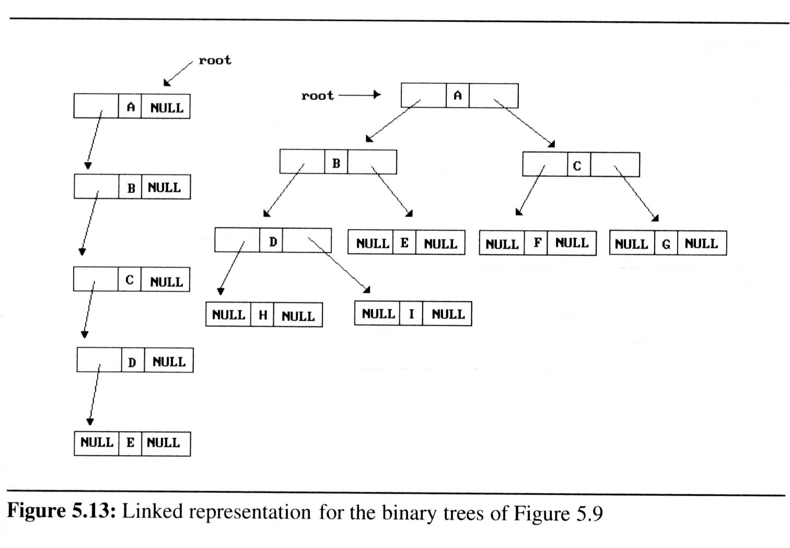
Binary Trees
Binary tree representations (using link)

Slide 12
Binary tree Properties

Slide 13

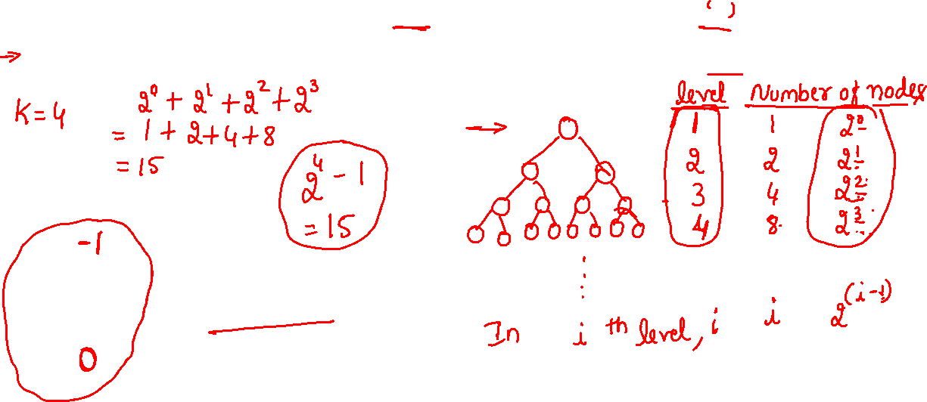
Maximum Number of Nodes in a Binary Tree
The maximum number of nodes on depth i of a binary tree is 2^{i-1}, i>=1.
The maximum number of nodes in a binary tree of height k is 2^{k}-1, k>=1.
Prove by induction.

Slide 14
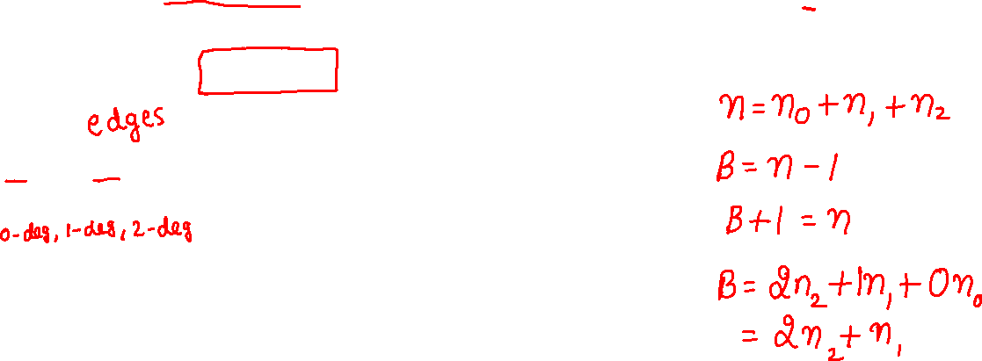
Relations between Number of
Leaf Nodes and Nodes of Degree 2
For any nonempty binary tree, T, if n₀ is the
number of leaf nodes and n₂ the number of nodes
of degree 2, then n₀=n₂+1
proof:
Let n and B denote the total number of nodes &
branches in T.
Let n₀, n₁, n₂ represent the nodes with no children,
single child, and two children respectively.
n= n₀+n₁+n₂, B+1=n, B=n₁+2n₂ ==> n₁+2n₂+1= n,
n₁+2n₂+1= n₀+n₁+n₂ ==> n₀=n₂+1

Slide 15
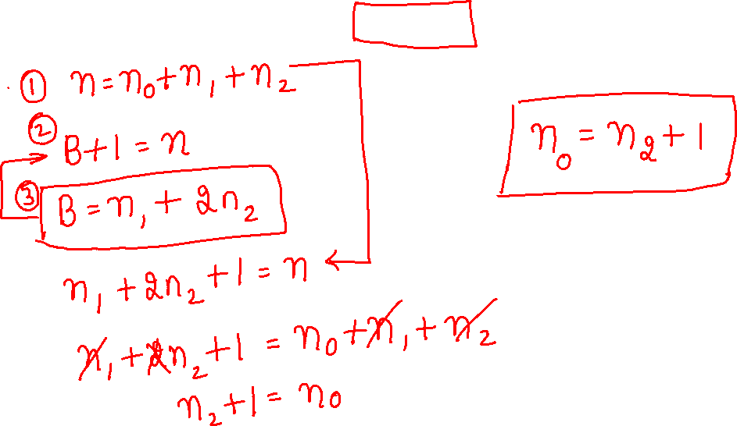
n= n₀+n₁+n₂, B+1=n, B=n₁+2n₂ ==> n₁+2n₂+1= n,
n₁+2n₂+1= n₀+n₁+n₂ ==> n₀=n₂+1

Slide 16
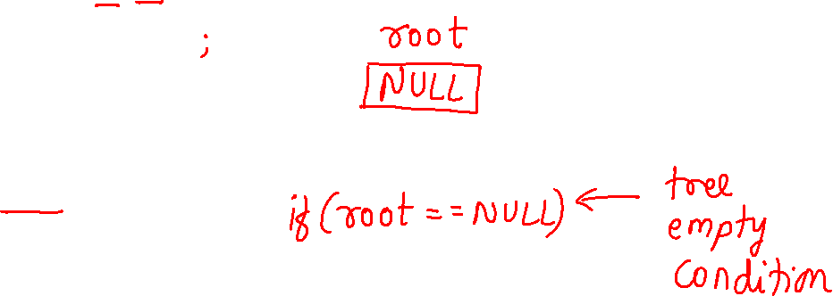
class treenode
{
int data;
treenode *lc,*rc;
public:
treenode *createBT()
void inorder(treenode *);
void postorder(treenode *);
void preorder(treenode *);
};
treenode *root=NULL;

Slide 17
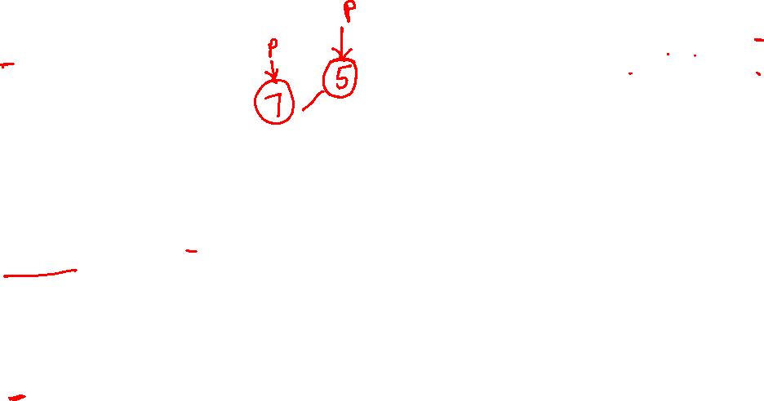
treenode *createBT()
{
treenode *p;
int x;
cout<<"Enter data(-1 for no data):";
cin>>x;
if(x==-1)
return NULL;
p=new tree_node;
p->data=x;
cout<<"Enter left child of “<<x<<“:”;
p->lc=createBT();
cout<<"Enter right child of “<<x<<“:”;
p->rc=createBT();
return p;
}
Binary tree creation using recursive method.
Enter data(-1 for no data):5
Enter left child of 5:
Enter data(-1 for no data):7
Enter left child of 7:
Enter data(-1 for no data):8
Enter left child of 8:
Enter data(-1 for no data):3
Enter left child of 3:
Enter data(-1 for no data):-1
Enter right child of 3:
Enter data(-1 for no data):-1
Enter right child of 8:
Enter data(-1 for no data):-1
Enter right child of 7:
Enter data(-1 for no data):-1
Enter right child of 5:
Enter data(-1 for no data):-1
Calling create function in main
  root=createBT();

Slide 18
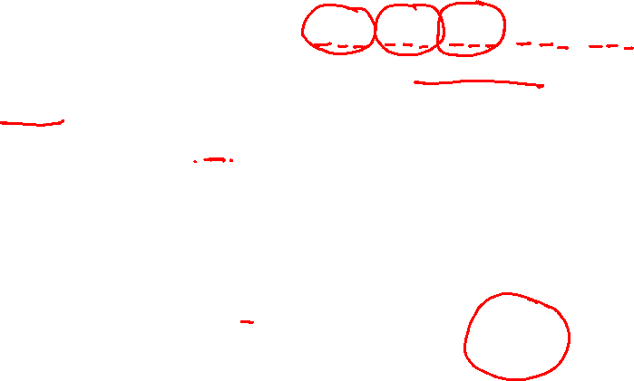

Binary Tree Traversals
How to traverse a tree or visit each node in the tree exactly once?
  There are six possible combinations of traversal
LVR, LRV, VLR, VRL, RVL, RLV
  Adopt convention that we traverse left before
  right, only 3 traversals remain
LVR (inorder), LRV (postorder), VLR (preorder)
left_child
data
right_child
V
:
visiting
node
L: moving left
R: moving right

Slide 19
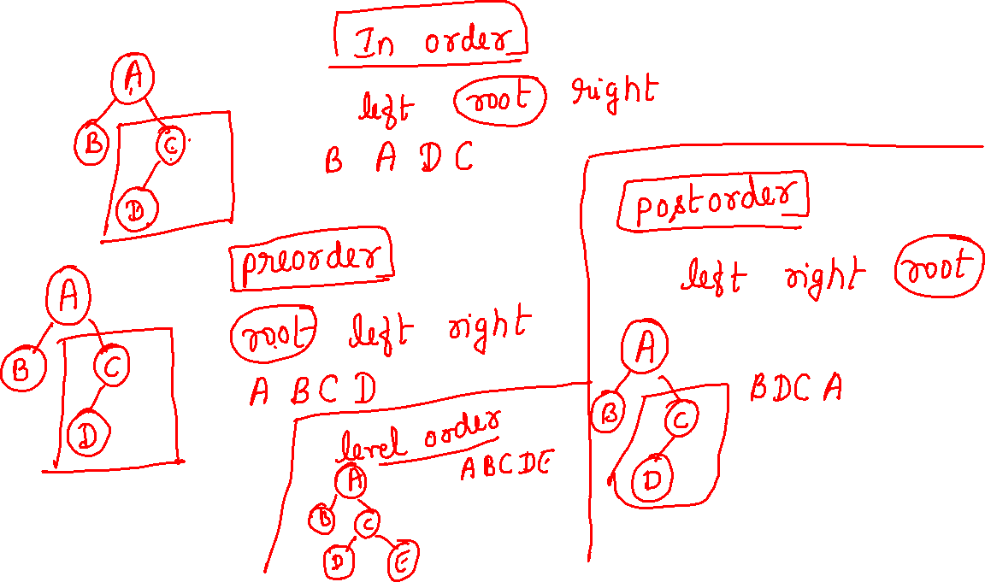

Slide 21
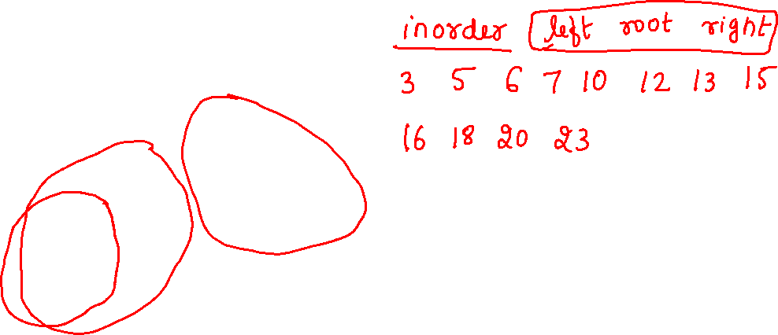

Slide 22
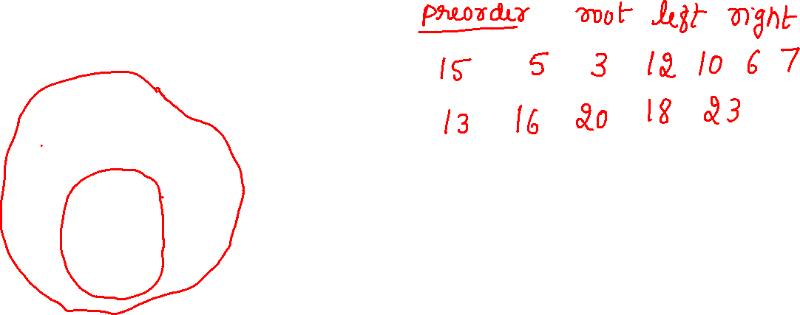

Slide 23
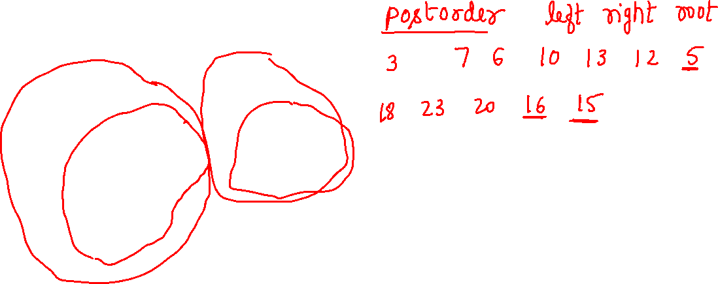

Slide 24
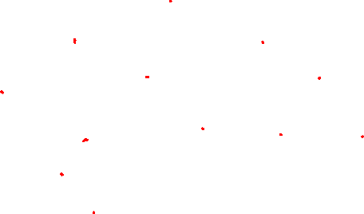
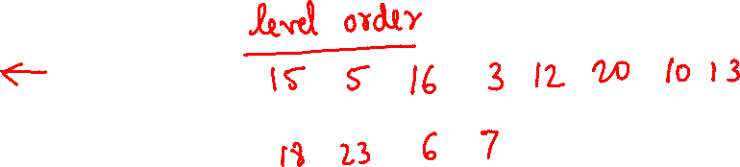

Slide 25
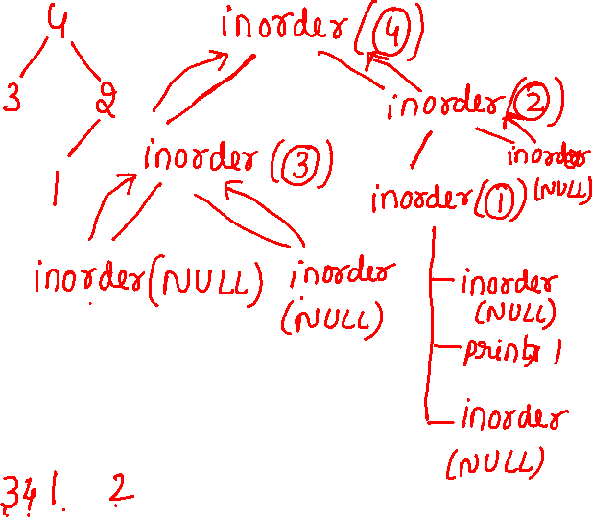
Inorder traversal
void *treenode::inorder(treenode *ptr)
{
if(ptr)
{
inorder(ptr->lc);
cout<<ptr->data<<“ ”;
inorder(ptr->rc);
}
}

Slide 26
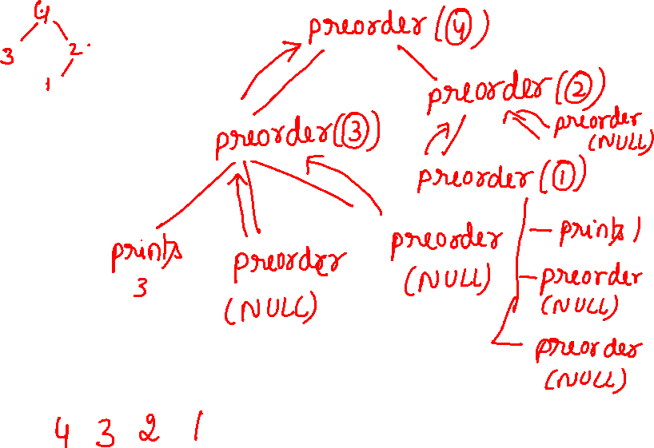
preorder traversal
void *treenode::preorder(treenode *ptr)
{
if(ptr)
{
cout<<ptr->data<<“ ”;
preorder(ptr->lc);
preorder(ptr->rc);
}
}

Slide 27
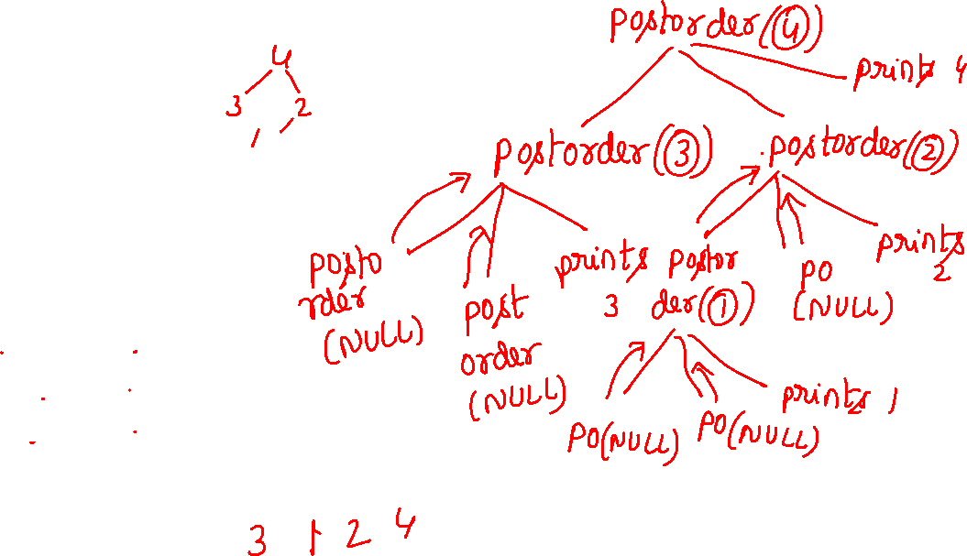
Postorder traversal
void *treenode::postorder(treenode *ptr)
{
if(ptr)
{
postorder(ptr->lc);
postorder(ptr->rc);
cout<<ptr->data<<“ ”;
}
}

Slide 28
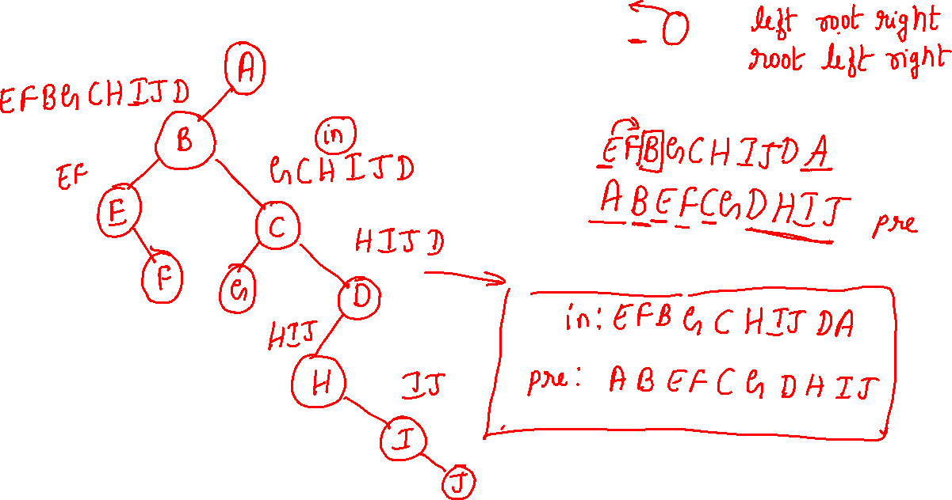
inorder: EFBGCHIJDA
preorder: ABEFCGDHIJ

